Slide 1

Part 3: Microsoft Powerpoint Presentation
Overview Of the Gadget Galaxy Company
Name : Israt Jahan Chaite
Batch no : 04
Department : Biochemistry and biotechnology
Date : 02/06/24

Slide 2
Introduction to Gadget Galaxy Company
Galaxy Gadgets is a prominent smartphone company specializing in cutting-edge mobile technology.
The flagship Galaxy Line features state-of-the-art smartphones with innovative features like AI-powered cameras and immersive displays.
Galaxy Gadgets prioritizes research and development to continuously enhance and push the boundaries of smartphone technology.
Galaxy Gadgets emphasizes exceptional service and support, actively engaging with customers to address their needs and preferences.

Slide 3
Products and Services of the Gadgets Galaxy company
1. Smartphones
2. Tablets
3. Laptops
4. Smartwatch
8. VR headsets
9. Fitnes
10. Smart home
Products

Slide 4
Services:
1. Device repair services
2. Tech support and troubleshooting assistance
3. Device customization options
4. Trade-in programs for old gadgets
5. Product warranties and extended protection plans
6. Installation and setup services
7. Personalized tech consultations
8. Software and firmware updates
9. Device recycling programs
10. Exclusive membership perks and discounts

Slide 5

Galaxy Gadget Company Analysis
Key Performance Indicators
Revenue Growth: Showing consistent growth quarter over quarter.
Cost of Goods Sold (COGS): Maintained in line with revenue, indicating good cost management.
Units Sold: Fluctuating slightly but overall showing an upward trend.
Financial Highlights
Q1 2024 & Q1 2027 had the highest revenue at $102,000,000.
Q2 2025 had the lowest revenue at $66,000,000.
Profit Margin is stable around 50%.

Slide 6
Total sales till now
Region | Total Sales (BDT)
Barishal | 5010000
Chittagong | 4340000
Khulna | 4110000
Rajshahi | 4760000
Sylhet | 4600000
Dhaka | 5850000

Slide 7
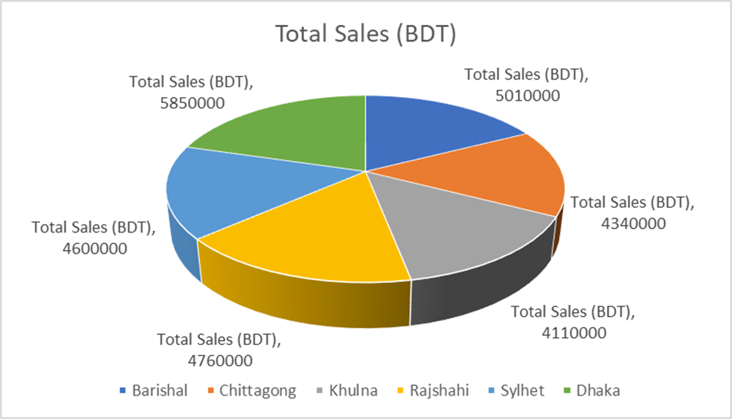

Slide 8

Conclusion
Sales Strategy
Focus on expanding sales in Q3 and Q4 to maximize revenue.
Consider promotional campaigns to boost sales during slower quarters.
Cost Management
COGS is consistently around 50% of revenue, indicating good cost control.
Monitor COGS closely to ensure profitability.
Future Outlook
Consistent revenue growth suggests a positive outlook.
Explore opportunities for product diversification and market expansion.

Slide 9
Visit : https://galaxy-gadgets.com/ for more details
Contact : 01755736885

